Slide 1
Transport in Animals

Slide 2
03 main factors that influence the need for a transport system
Size
Surface area to volume ratio
Level of metabolic activity

Slide 3
Features of a good transport system
A fluid – to carry materials around the body (blood)
A pump – to create the pressure in order to push the fluid around the body (heart)
Exchange surfaces – enable the substances to enter the blood and leave it. (capillaries)

Slide 4
An efficient transport system also will include;
Tubes or vessels – to carry blood by mass flow
Two circuits – One to pick up oxygen and another to deliver oxygen to the tissues

Slide 5
Single Circulatory System
A type of blood circulation found in fish and some other animals where the blood passes through the heart only once during each complete circuit of the body.
Example: Fish
In fish, the heart pumps deoxygenated blood to the gills for gas exchange. The oxygenated blood from the gills then flows directly to the rest of the body, and then back to the heart.
The Circulation Path:
Heart →
Gills (for oxygen uptake and carbon dioxide removal) →
Body tissues (oxygen is delivered, carbon dioxide is collected) →
Back to the heart

Slide 6
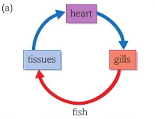
Heart Structure in Fish
Fish have a 2-chambered heart:
1 atrium (receives blood)
1 ventricle (pumps blood)

Slide 7
Limitations
Blood loses pressure after passing through the gills.
So, blood flows more slowly to the body.
This makes the system less efficient for delivering oxygen compared to double circulatory systems (like in mammals).

Slide 8
Double Circulation
The blood passes through the heart twice during one complete circuit of the body.
Example: Humans and Mammals
There are two loops in a double circulatory system:
1. Pulmonary Circulation (Lungs)
Right side of the heart pumps deoxygenated blood to the lungs.
Blood gets oxygenated and returns to the left side of the heart.
2. Systemic Circulation (Body)
Left side of the heart pumps oxygenated blood to the rest of the body.
Blood delivers oxygen, picks up CO₂, and returns deoxygenated to the right side of the heart.

Slide 9
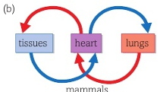
Heart Structure in Mammals
4 chambers:
2 atria (left and right)
2 ventricles (left and right)

Slide 10
Advantages of Double Circulation:
Advantage | Explanation
High pressure to body | Blood is pumped to the body with more force → faster delivery of oxygen and nutrients.
Low pressure to lungs | Prevents damage to delicate lung tissue.
Efficient oxygen supply | Supports active lifestyles and warm-blooded animals.

Slide 11
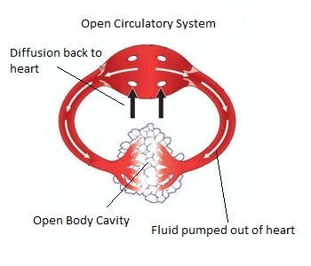
Open Circulatory System
An open circulatory system is a type of blood circulation where the blood is not always enclosed in blood vessels. Instead, it flows freely through open spaces or cavities in the body.
Example: Insects (like grasshoppers, beetles)
How It Works:
The heart (usually a long, tube-like structure) pumps blood-like fluid called haemolymph.
Haemolymph is pumped into the body cavity (called the haemocoel).
It bathes the organs directly, allowing exchange of nutrients and wastes.
Haemolymph eventually returns to the heart through openings called ostia.

Slide 12
Key Points:
No capillaries or small blood vessels.
Haemolymph mixes with body fluids.
Not used for oxygen transport in insects — they rely on the tracheal system for gas exchange.

Slide 13
Advantages:
Requires less energy to maintain.
Simple and suitable for small animals with low metabolic rates.
Disadvantages:
Slow circulation.
Less control over blood flow to specific organs.
Not efficient for large or very active animals.

Slide 14
How Haemolymph Moves:
Heart Contraction (Dorsal Vessel)
Insects have a dorsal tubular heart that runs along the top of the body (dorsal side).
The heart contracts rhythmically, pumping haemolymph forward toward the head.
Flow into the Body Cavity (Haemocoel)
Haemolymph is pumped out through vessels and enters the haemocoel—an open body cavity.
It bathes organs directly, allowing nutrient and waste exchange.
Return to the Heart
As the heart relaxes, haemolymph is drawn back into the heart through tiny valve-like openings called ostia.
These ostia have valves that prevent backflow.

Slide 15
Movement Helped by Body Activity:
Body movement
Heart pumps

Slide 16
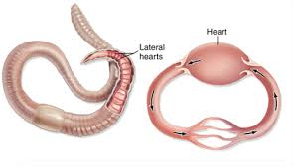
Closed Circulatory System
Blood is restricted to vessels and kept separate from interstitial fluid.
Heart pumps blood into large vessels → branch into small vessels → penetrate organs.
Chemical exchange:
Between blood ↔ interstitial fluid
Interstitial fluid ↔ body cells
May contain one or more hearts.
Found in vertebrates and some invertebrates (e.g., annelids).
Compared to open system:
Higher blood pressure
Enables efficient delivery of oxygen & nutrients
Supports larger and more active animals

Slide 17
Transport of Oxygen by Hemoglobin
1. Role of Red Blood Cells
Oxygen is transported in red blood cells (erythrocytes).
Each RBC contains about 280 million hemoglobin molecules.
Each hemoglobin can carry 4 oxygen molecules → over 1 billion oxygen molecules per RBC.

Slide 18
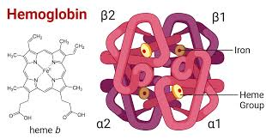
2. Hemoglobin Structure
Protein with 4 subunits: each has a polypeptide chain + heme group.
Heme group contains Fe²⁺, which binds 1 O₂ molecule.
High affinity for oxygen; binding is reversible.
3. Association & Dissociation
Association (binding of O₂) occurs in the lungs (high PO₂).
Dissociation (release of O₂) occurs in respiring tissues (low PO₂).
Maintains steep concentration gradient for efficient gas exchange.

Slide 19
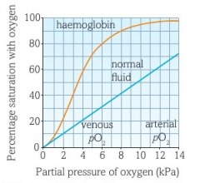
4. Hemoglobin Dissociation Curve
S-shaped (sigmoid) curve:
  Low PO₂: difficult for first O₂ to bind.
  Middle range: easy binding after first O₂ → conformational change.
  High PO₂: saturation levels off as hemoglobin approaches full capacity.
Adaptation
In lungs: PO₂ is high → near 100% saturation.
In tissues: PO₂ is low → O₂ readily released for aerobic respiration.

Slide 20
Fetal Hemoglobin (HbF)
1. Structural Difference
Fetal hemoglobin is slightly different in structure from adult hemoglobin (HbA).
HbF has a higher affinity for oxygen than HbA.
2. Hemoglobin Dissociation Curve
HbF curve is shifted to the left of the adult hemoglobin curve.
This means HbF can bind oxygen more readily at lower oxygen tensions.
3. Oxygen Transfer from Mother to Fetus
In the placenta, oxygen tension is low.
Adult hemoglobin releases oxygen, and fetal hemoglobin absorbs it.
This reduces local oxygen tension further → more oxygen diffuses from maternal blood to fetus.
✅ Adaptation Advantage
Ensures the fetus receives enough oxygen, even when oxygen levels are relatively low in the placenta.

Slide 21

Transporting Carbon Dioxide
Carbon Dioxide Transport in Blood
5%: Dissolved directly in plasma
10%: Binds to hemoglobin → carbaminohemoglobin
85%: Transported as *hydrogen carbonate ions (HCO₃⁻)
2. Formation of Hydrogen Carbonate Ions
CO₂ diffuses into RBCs → combines with H₂O → forms carbonic acid (H₂CO₃)
Carbonic anhydrase catalyzes this reaction
H₂CO₃ dissociates → H⁺ + HCO₃⁻
HCO₃⁻ exits RBC, Cl⁻ enters → chloride shift
H⁺ binds to hemoglobin → forms hemoglobinic acid (HHb)
→ Hemoglobin acts as a buffer to maintain pH

Slide 22
Bohr Effect: The Role of CO₂ in Oxygen Release
High CO₂ → more carbonic acid → H⁺ ions → lower pH
Low pH alters hemoglobin’s tertiary structure
Reduced affinity for oxygen → oxygen is released to tissues
Hemoglobin dissociation curve shifts right & downward
→ This is the Bohr shift
Physiological Advantage
In active tissues (e.g., muscles), more CO₂ → more O₂ released
Supports aerobic respiration during high metabolic activity

