Slide 1
Cardio Vascular Diseases

Slide 2
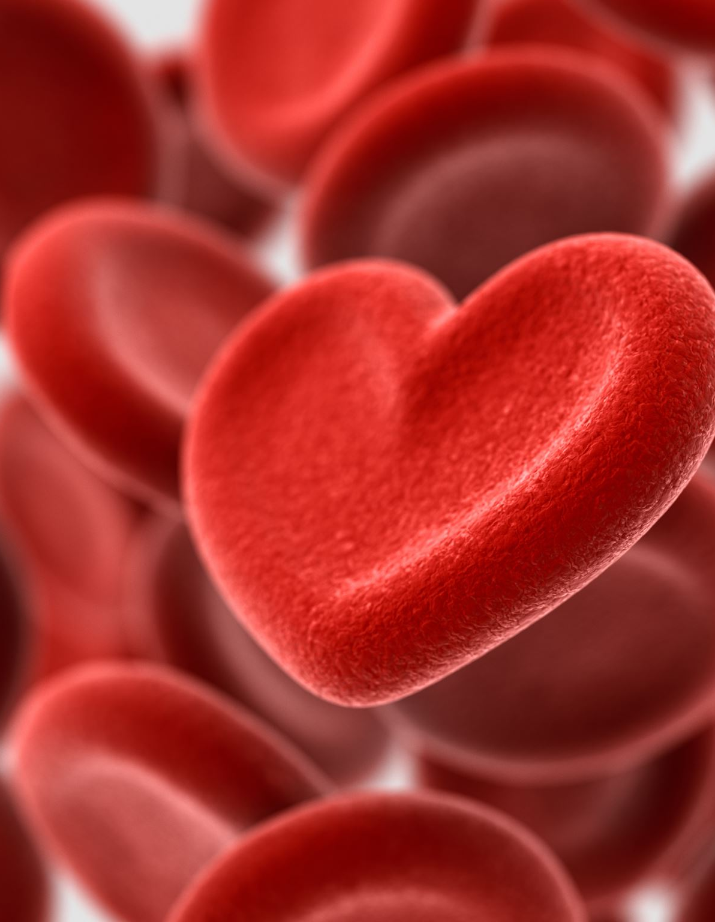
The Effect of Atherosclerosis on Health
What is Atherosclerosis?
Progressive damage to the artery endothelium
Triggered inflammatory response
Cholesterol accumulates → forms atheroma
Atheroma hardens with fibrous tissue and calcium salts → plaque
Leads to narrowing and loss of elasticity in arteries

Slide 3
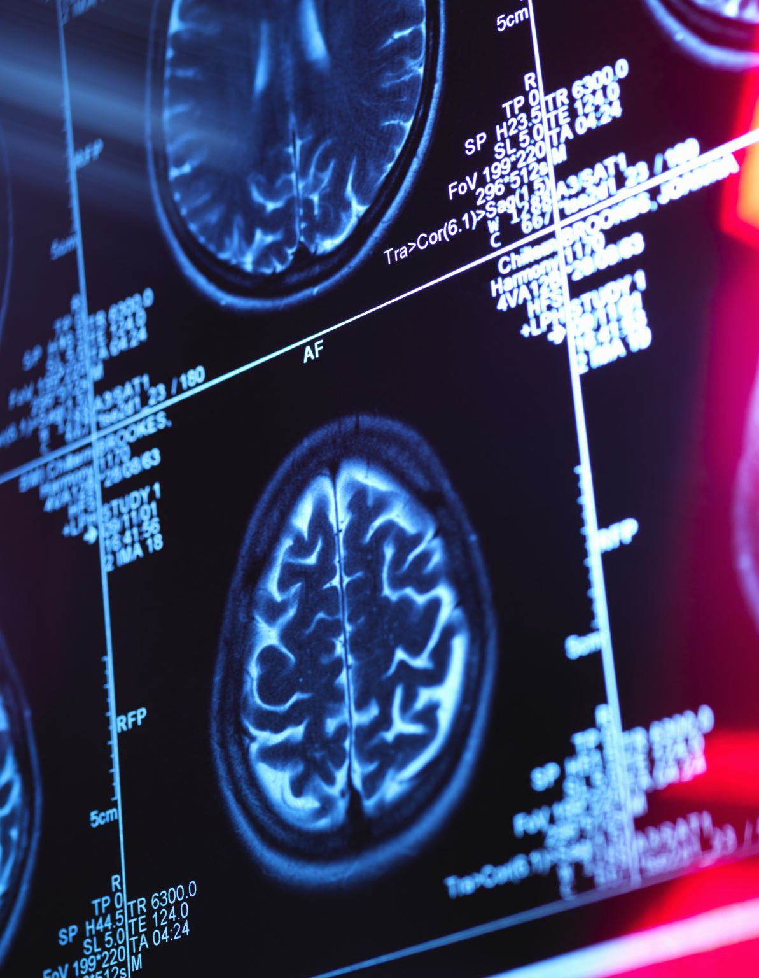
Complication: Aneurysm
Plaque narrows artery → blood collects behind blockage
Causes artery to bulge → increases pressure on the wall
Wall weakens → may split open (rupture)
Massive internal bleeding occurs → often fatal
Common Sites
Aorta (especially in the abdomen)
Arteries supplying the brain
Management
Early diagnosis by imaging
Surgical treatment to reinforce or remove weakened vessel

Slide 4
How Atherosclerosis Raises Blood Pressure
Arteries narrowed by plaque → increased resistance to blood flow
Leads to chronically raised blood pressure (hypertension)

Slide 5
Raised Blood Pressure
🧠 Brain
Capillary rupture → internal bleeding
Can lead to a type of stroke
👁️ Eyes (Retina)
Tiny vessels damaged
Blocked or leaky vessels starve retina of oxygen
May lead to vision loss or blindness
🧪 Kidneys
High pressure damages filtering capillaries
Proteins leak into urine (proteinuria)
Can cause kidney failure if untreated

Slide 6

1. Coronary Heart Disease (CHD)
Angina (Chest Pain)
Caused by narrowed coronary arteries
Reduced oxygen to heart muscle → anaerobic respiration
Symptoms:
  Gripping chest pain (radiating to left arm/jaw)
  Breathlessness
  Triggered by exercise, relieved by rest
Treatment:
  Lifestyle changes, vasodilator drugs
  Stents or bypass surgery for severe cases

Slide 7
Myocardial Infarction (Heart Attack)
Often due to coronary thrombosis (blood clot)
Clot blocks oxygen to heart muscle → tissue dies
Severe chest pain (can occur anytime)
May lead to sudden death
⚠️ Emergency Treatment:
2 full-strength aspirin tablets
Get medical help immediately

Slide 8
2. Stroke
Caused by blocked or burst blood vessels in brain
⚠️ Due to blood clot, atheroma, or capillary bleeding
Symptoms of Stroke
Dizziness, confusion, slurred speech
Blurred/partial vision loss
Numbness or paralysis (usually one side)
Severity depends on location and size of affected area

Slide 9
Non-Modifiable Risk Factors of Cardiovascular Disease (CVD)
1. Genetics
Some families/ethnic groups have a genetic tendency toward CVD
May include:
  Easily damaged arteries
  Tendency for high blood pressure (hypertension)
  Cholesterol imbalances

Slide 10
2. Age
As we age, blood vessels:
  Lose elasticity
  Become slightly narrowed
Increases risk of heart disease and stroke
🚹🚺 3. Gender
Men under 50 have a higher risk of heart disease
Estrogen in women protects against plaque buildup
After menopause, estrogen drops → risk increases

Slide 11
Modifiable Risk Factors
Smoking
Damages artery endothelium → triggers atherosclerosis
Increases blood pressure & heart rate
Raises levels of carbon monoxide in blood → reduces oxygen supply
Physical Inactivity
Leads to low HDL ("good") cholesterol
Contributes to weight gain and poor circulation
Reduces efficiency of the cardiovascular system

Slide 12
High Blood Pressure (Hypertension)
Damages arterial walls → encourages plaque formation
Increases risk of stroke, heart attack, and kidney damage
Unhealthy Diet
High in saturated fats, salt, and sugar
Raises LDL ("bad") cholesterol levels
Contributes to obesity and hypertension
Obesity
Increases strain on the heart
Often linked to type 2 diabetes, high cholesterol, and hypertension
Major risk factor for atherosclerosis and CVD

Slide 13
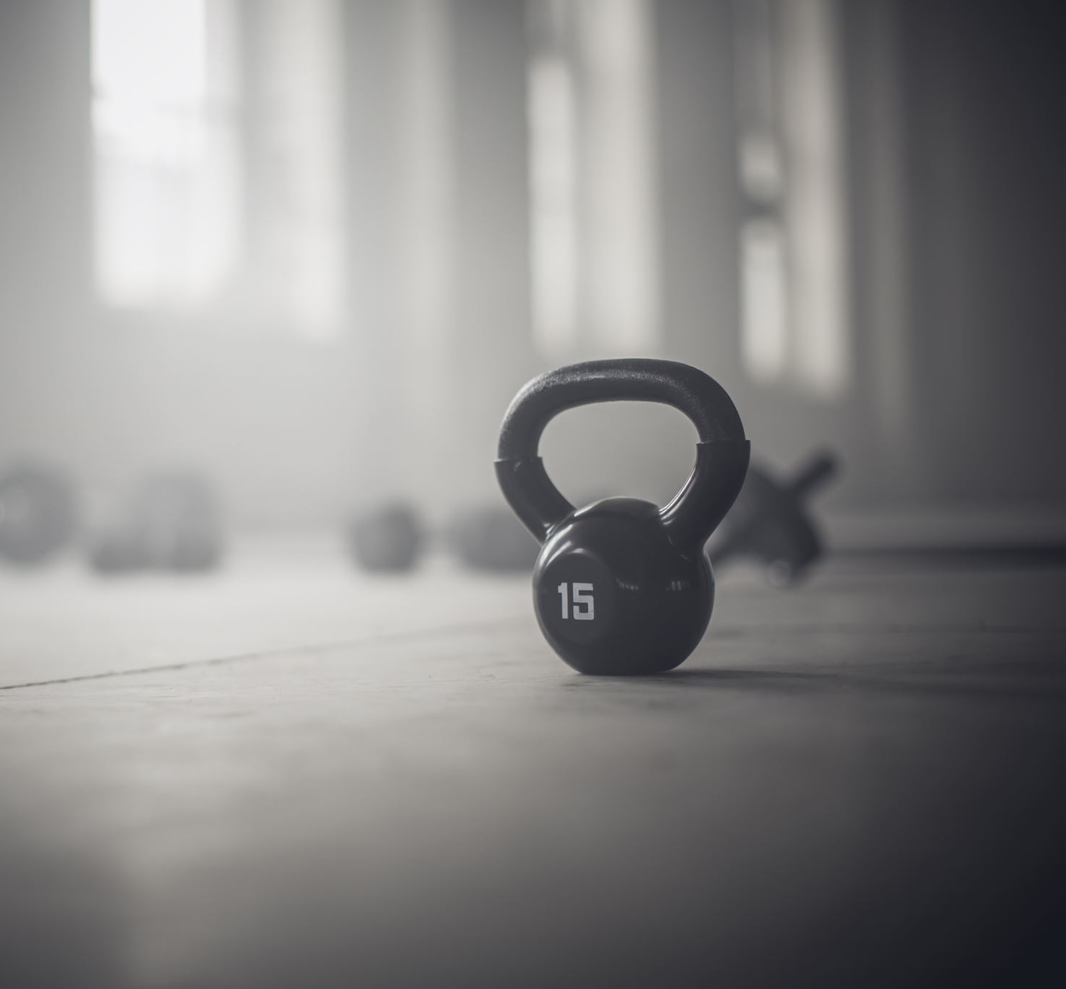
Body – Mass Index (BMI)
This decides whether you are unhealthy heavy.
BMI = Weight (kg) / Height (m)
BMI < 18 kgm-2 : Underweight
BMI < 18.5 - 25 Kgm-2 : Ideal range
BMI > 25-30Kgm-2 : Obese
BMI > 40Kgm-2 : Morbidly Obese

Slide 14
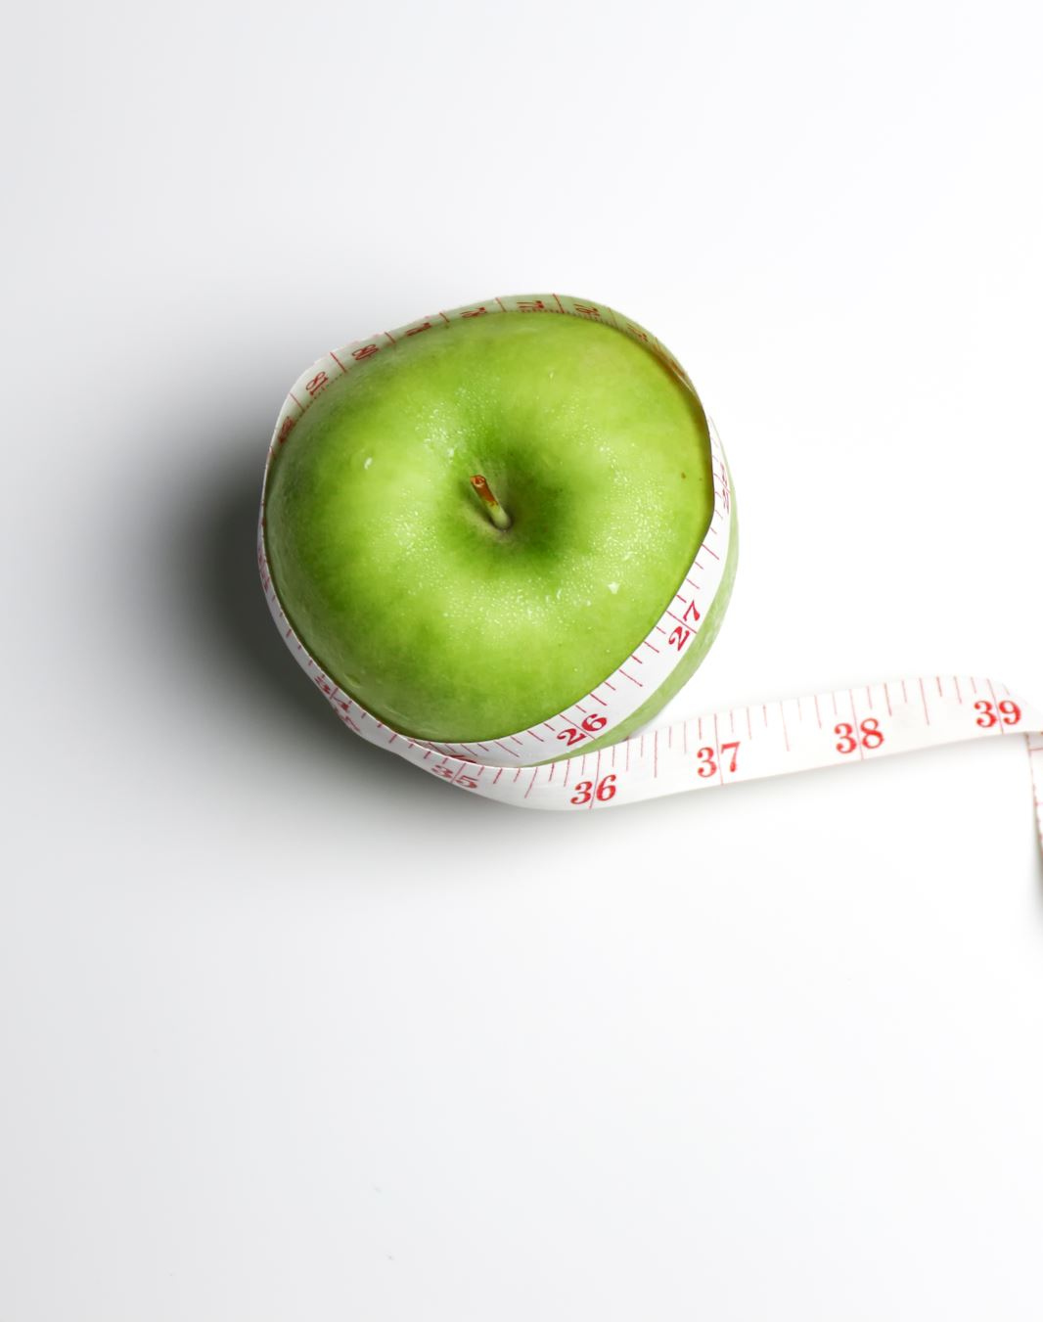
Waist – Hip Ratio
The waist is measured just above the navel and the hip at the widest point of the hip.
Waist (cm) / Hip Size (cm)
Waist size gives a good indication of amount of fat a person is carrying
Male > 0.9
Female > 0.85

Slide 15
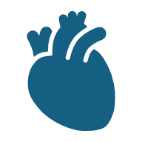
LDL, HDL & Cardiovascular Disease (CVD)
LDL – Low-Density Lipoprotein ("Bad Cholesterol")
Transports cholesterol from liver to body cells
Excess LDL → cholesterol deposits in artery walls
Leads to plaque formation (atherosclerosis)
Increases risk of:
  Coronary heart disease
  Stroke
  Heart attack

Slide 16
HDL – High-Density Lipoprotein ("Good Cholesterol")
Removes excess cholesterol from blood
Carries it back to the liver for breakdown
Protects arteries from plaque buildup
Higher HDL levels = Lower risk of CVD

Slide 17

Healthy Ratio
Ideal ratio: Below 3.5:1
  Means less LDL relative to HDL
  Lower risk of atherosclerosis and heart disease
High Ratio = Higher Risk
More LDL than HDL → more plaque formation
Increases risk of:
  Blocked arteries
  Heart attack
  Stroke
How to Improve the Ratio
Increase HDL:
  Exercise, healthy fats (e.g., olive oil, nuts)
Reduce LDL:
  Avoid saturated & trans fats
  Quit smoking
  Manage weight and stress

Slide 18
Antioxidants & Cardiovascular Disease (CVD)
What are Antioxidants?
Substances that neutralize free radicals (unstable, damaging molecules)
Found in:
  Fruits & vegetables (vitamins C, E)
  Whole grains, nuts, seeds

Slide 19
How Do Free Radicals Harm the Cardiovascular System?
Free radicals damage the endothelium of arteries
This damage can trigger atherosclerosis
Promotes LDL oxidation, making it more likely to form plaque
How Antioxidants Help
Prevent oxidative damage to blood vessels
Protect LDL from oxidation
Help maintain healthy arteries and reduce risk of:
  Heart attack
  Stroke

Slide 20
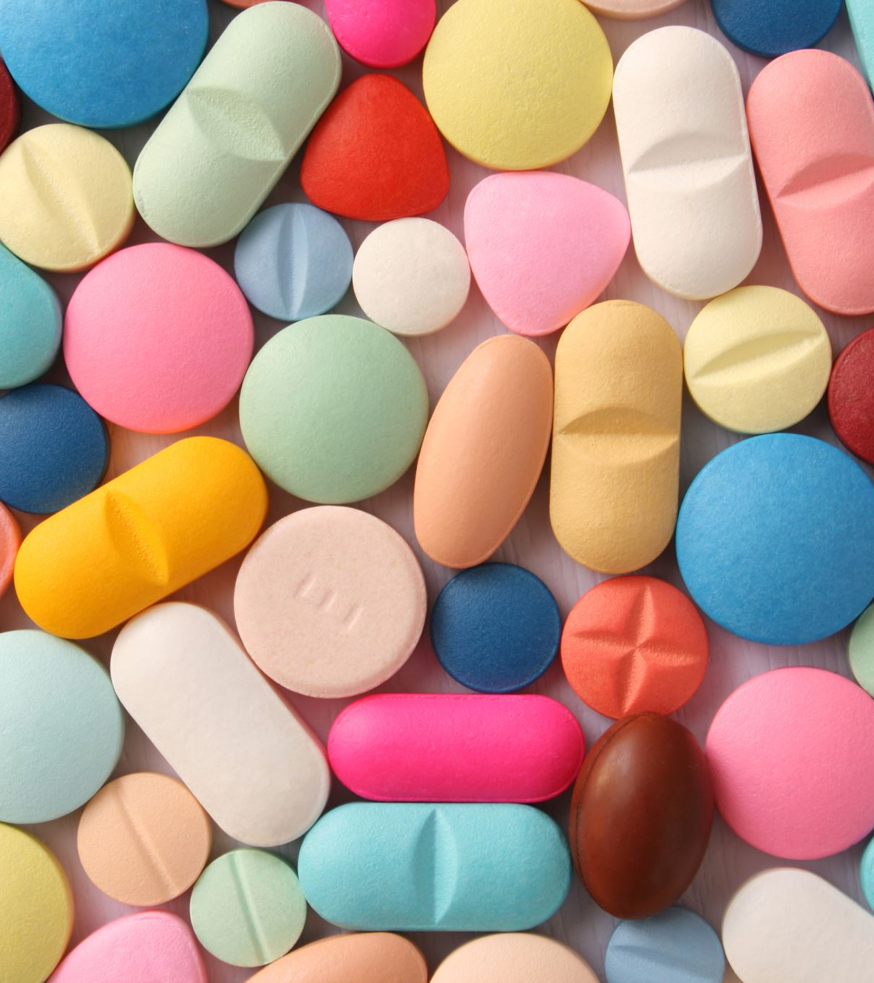
Controlling Blood Pressure to Reduce CVD Risk
Types of Antihypertensive Drugs
1. Diuretics ("Water Pills")
Increase urine output → reduce blood volume
Lowers blood pressure
Often first-line treatment
🛡️ 2. Beta Blockers
Block effects of adrenaline
Slow heart rate and reduce cardiac output
Useful after heart attacks
🌙 3. Sympathetic Nerve Inhibitors
Reduce nerve signals that constrict blood vessels
Cause vasodilation → lowers resistance to blood flow

Slide 21
Statins
What Are Statins?
Drugs used to lower blood cholesterol levels, especially LDL (bad cholesterol)
Commonly prescribed to prevent cardiovascular disease (CVD)
⚙️ How Do They Work?
Inhibit an enzyme in the liver called HMG-CoA reductase
This enzyme is needed to make cholesterol
Liver then removes LDL from the blood to compensate
Possible Side Effects
Muscle pain or weakness
Liver damage (rare)
Digestive problems
Increased risk of diabetes (in some people)

Slide 22
Anticoagulants & Platelet Inhibitory Drugs
1. Anticoagulants
Prevent formation of blood clots by interfering with the clotting cascade
Common drugs:
  Warfarin – blocks vitamin K-dependent clotting factors
  Heparin – enhances action of antithrombin (inhibits thrombin)
  ✅ Use:
Reduce risk of stroke, deep vein thrombosis (DVT), pulmonary embolism, and heart attack
⚠️ Risk:
Increased risk of excessive bleeding
Must be carefully monitored

